Slide 1
CS492 - Operating Systems Introduction to Linux
Georgios Portokalidis & Jun Xu
Reading: MOS Ch 10.2, LDD Ch 1
Slides credit: Antonio Barbalace
Notes:
Why Linux? It is one of the most popular variants of UNIX that runs on a variety of machines, including phones, cf. Android
We will use Linux in our labs in order to have a practical experience with OSes

Slide 2
Content
Linux goals
Linux interfaces
Linux internals
Linux extensibility

Slide 3
UNIX and Linux Goals
Designed by programmers, for programmers
Multiuser
Designed to be
Simple
Elegant
Consistent
Powerful
Flexible
Based on the concept of file
Everything is a file

Slide 4
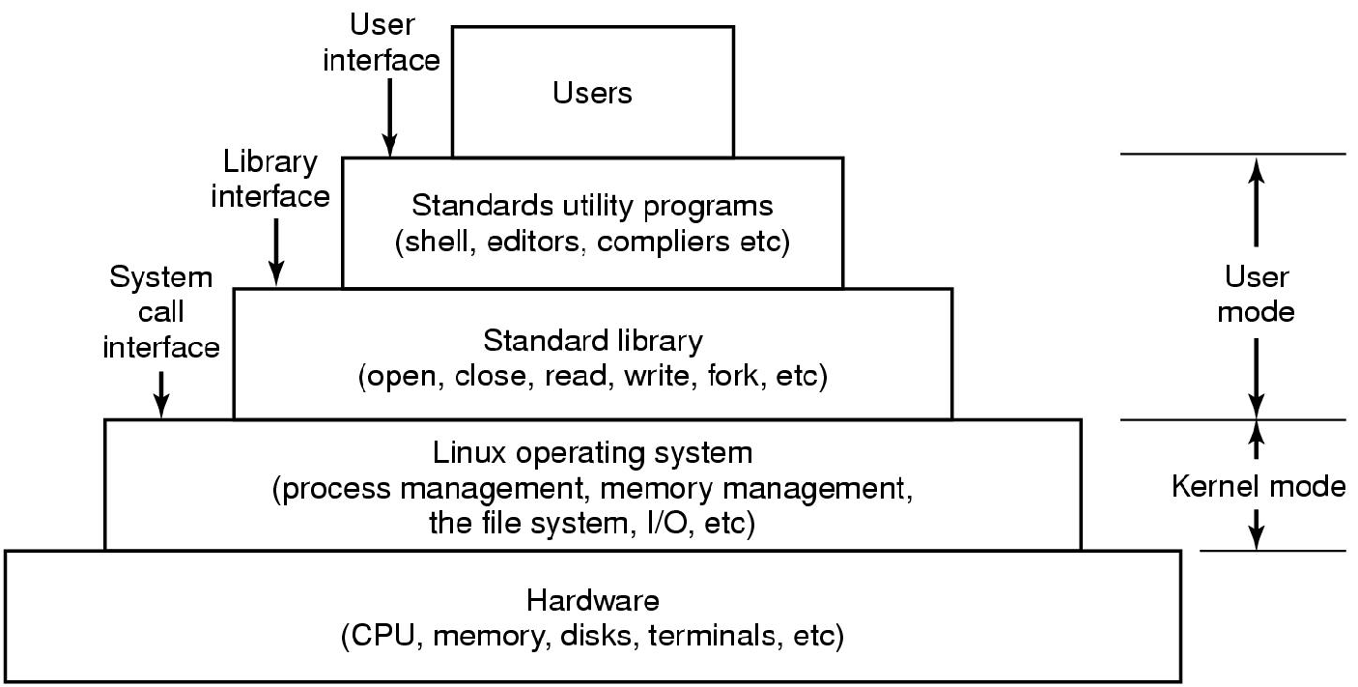
Interfaces to Linux
(e.g., libc)
kernel
Layers in a Linux Systems (MOS Figure 10-1)
Notes:
In the next slides we will see something about each layer

Slide 5
Interfaces to Linux
(e.g., libc)
kernel
Layers in a Linux Systems (MOS Figure 10-1)
Notes:
In the next slides we will see something about each layer

Slide 6
Interacting with Linux
Graphical User Interface (GUI)
X11
Shell
Bourne
bash (Bourne Again SHell)
ksh
csh
…
Notes:
What is important here is simply the observation that the shell is an ordinary user program. All it needs is the ability to read from the keyboard and write to the monitor and the power to execute other programs.

Slide 7
Interfaces to Linux
(e.g., libc)
kernel
Layers in a Linux Systems (MOS Figure 10-1)
Notes:
In the next slides we will see something about each layer

Slide 8
Standard Utility Programs (1)
File and directory manipulation commands
Filters
Program development tools
Editors, compilers
Text processing
System administrator
Miscellaneous
The POSIX 1003.1-2008 standard specifies the syntax and semantics of about 150 of these, primarily in the first three categories

Slide 9
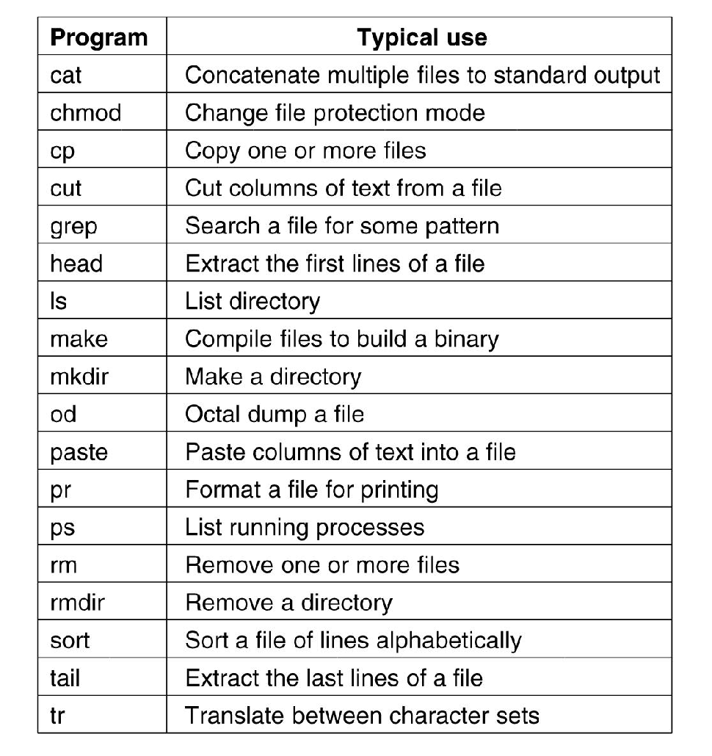
Standard Utility Programs (2)
A few of the common Linux utility programs required by POSIX (MOS Figure 10-2)

Slide 10
Interfaces to Linux
(e.g., libc)
kernel
Layers in a Linux Systems (MOS Figure 10-1)
Notes:
In the next slides we will see something about each layer

Slide 11
Standard Library
There is no way to write a system call instruction in C
A library is provided with one procedure per system call
This is stated in the MOS book, but it is imprecise
More accurately: “The C standard library or libc is the standard library for the C programming language.”
Linux libc is a superset of the C library POSIX specification
POSIX defines: which library procedures a conformant system must supply, what their parameters are, what they must do, and what results they must return
It does not mention the actual system calls
However, many times they are similar (e.g., read(), write(), etc.)

Slide 12
Portable Operating System Interface (POSIX)
Defines a portable interface including multiple aspects of the OS interface
For example POSIX.1: Core Services (incorporates Standard ANSI C) (IEEE Std 1003.1-1988) covers:
Process Creation and Control
Signals
Floating Point Exceptions
Segmentation / Memory Violations
Illegal Instructions
Bus Errors
Timers
File and Directory Operations
Pipes
C Library (Standard C)
I/O Port Interface and Control
Process Triggers

Slide 13
POSIX
1003.1 standard, addresses only the system calls*
Related standards
Threads (pthread)
Utility programs
Networking
…
The C language is ANSI and ISO standard

Slide 14
Interfaces to Linux
(e.g., libc)
kernel
Layers in a Linux Systems (MOS Figure 10-1)
Notes:
In the next slides we will see something about each layer

Slide 15
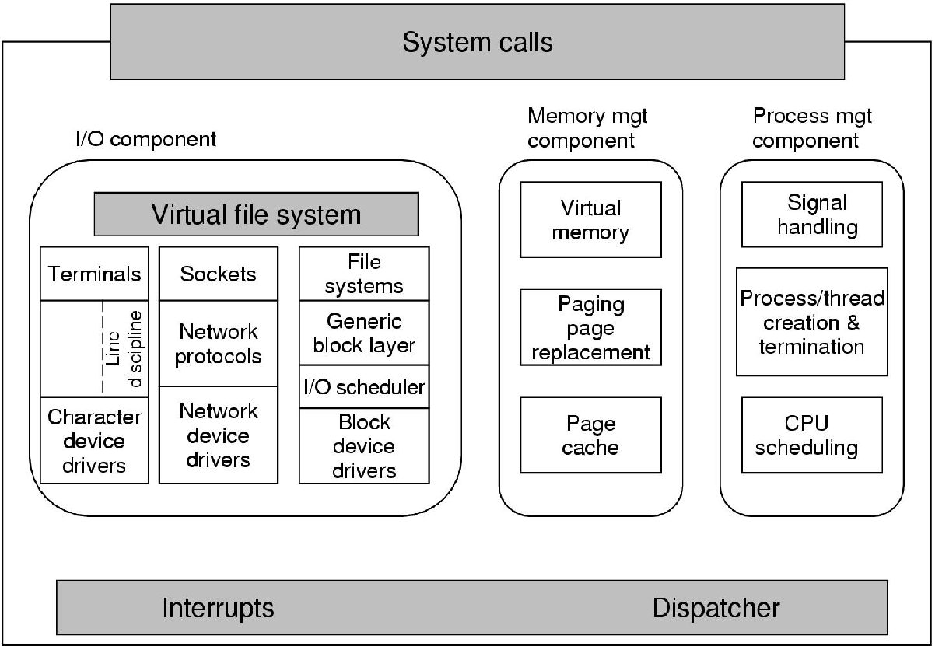
Linux Kernel (from the Book)
Structure of the Linux kernel (MOS Figure 10-3)
Notes:
Page cache is not really placed in the right box …

Slide 16
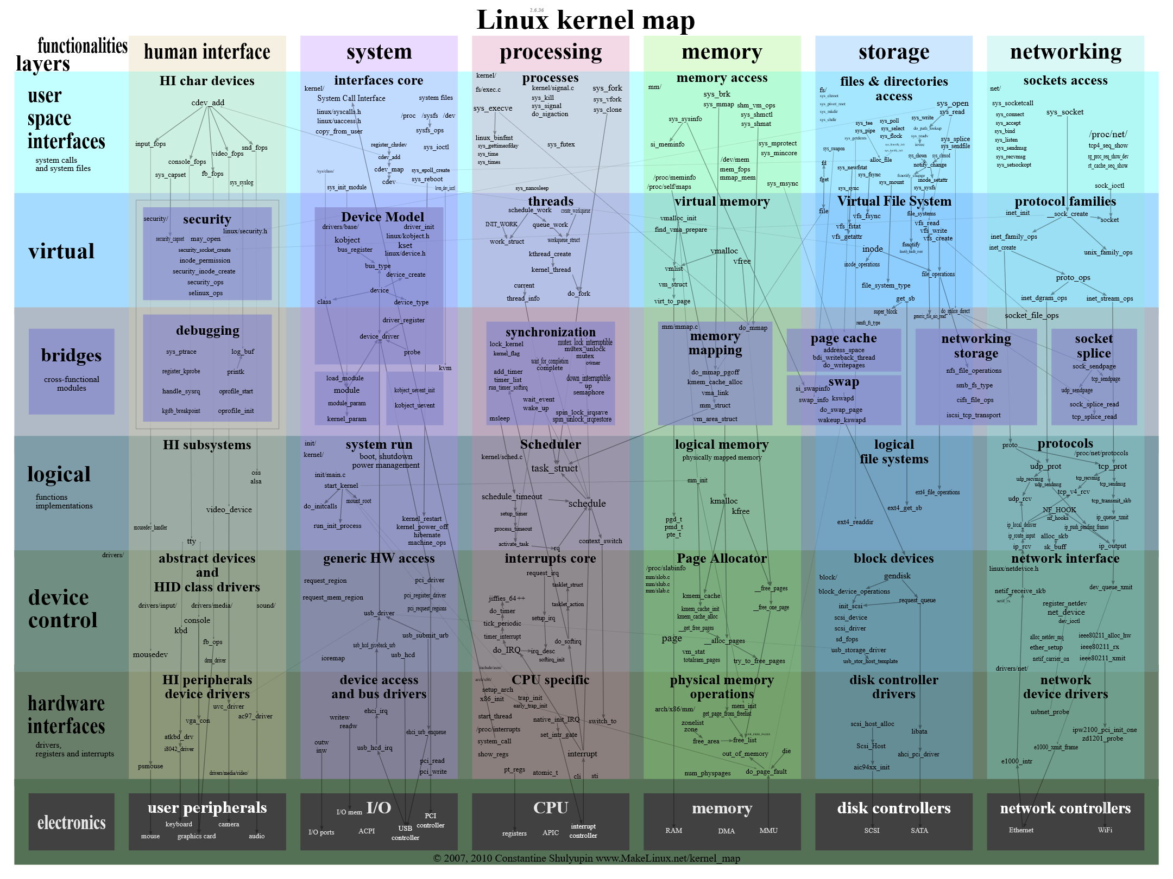
Linux Kernel (the Reality)
https://github.com/makelinux/linux_kernel_map/blob/master/LKM.svg

Slide 17
Linux Kernel Source Code
Notes:
demo

Slide 18
Where to Find the Kernel?
In your Linux distribution (already compiled)
Ubuntu, Debian, RedHat, …
Where exactly?
/boot/vmlinuz-X.Y.Z
Download the sources at https://www.kernel.org
Click the large button to get the latest version
Want a specific version?
https://www.kernel.org/pub/ -> linux -> kernel -> vX.Y -> linux.X.Y.Z.tar.{gz|xz}

Slide 19
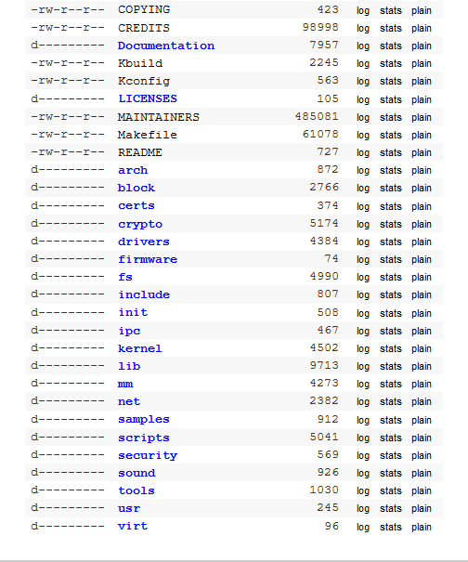
Linux Kernel Source Code (v4.20.1)

Slide 20
Kernel Source Directory Tree (1)
Interesting folders
arch/ architecture specific code, contains one folder per supported architecture
alpha, arc, arm, arm64, avr32, blackfin, c6x, cris, frv, h8300, hexagon, ia64, m32r, m68k, metag, microblaze, mips, mn10300, nios2, openrisc, parisc, powerpc, s390, score, sh, sparc, tile, um, unicore32, x86, xtensa
Example of architecture specific code: boot process, context switch, page table management, etc.
include/ kernel header files
init/ kernel initialization code
Note that most of the boot process is architecture specific and actually contained in arch/
mm/ memory management
drivers/ device drivers

Slide 21
Kernel Source Directory Tree (2)
Interesting folders
ipc/ Inter-Process Communication
fs/ filesystems
kernel/ generic core kernel
net/ networking
block/ block layer
lib/ helper libraries
scripts/ scripts used during the kernel configuration and compilation process
Documentation/ kernel documentation (text files)
samples/ example of usage of some kernel functions/mechanisms
tools/ a set of user space programs, scripts, for various usage (debugging, tracing, performance evaluation, etc.)

Slide 22
Exploring the Source Code: Linux Cross Reference
Code indexing tool with a web interface
Don’t install it! One instance is running at
https://elixir.bootlin.com/
Allows to
Browse the code of different Linux versions
Search for identifiers (functions, variables, etc.)
Quickly lookup a function declaration/definition

Slide 23
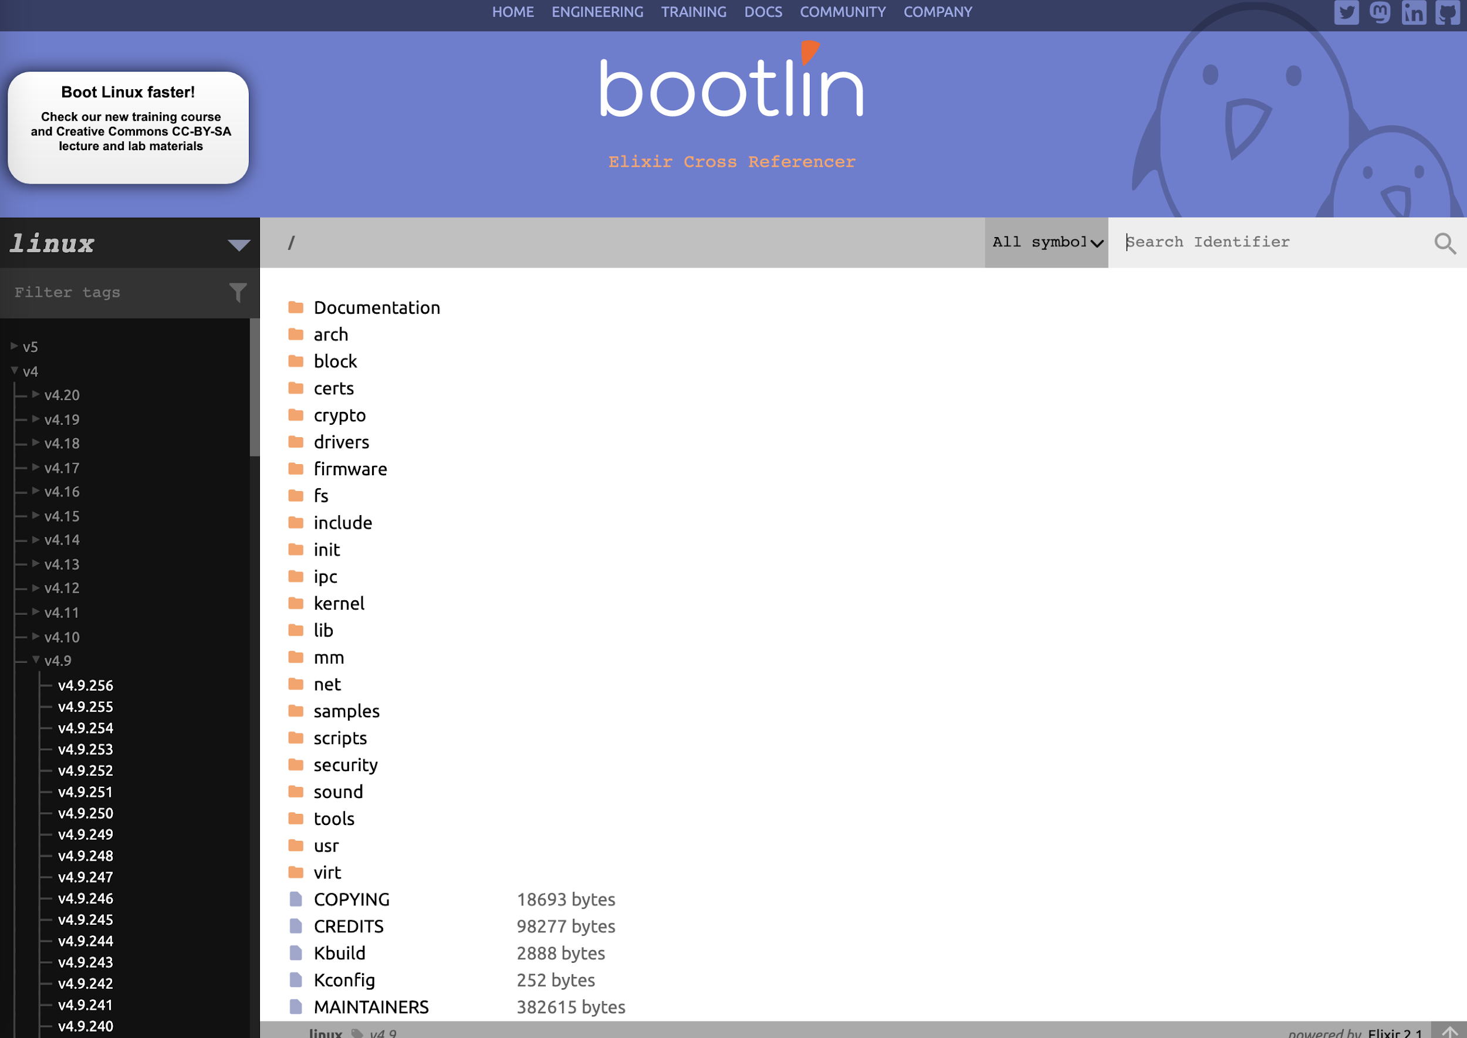
Linux Cross Reference (1)

Slide 24
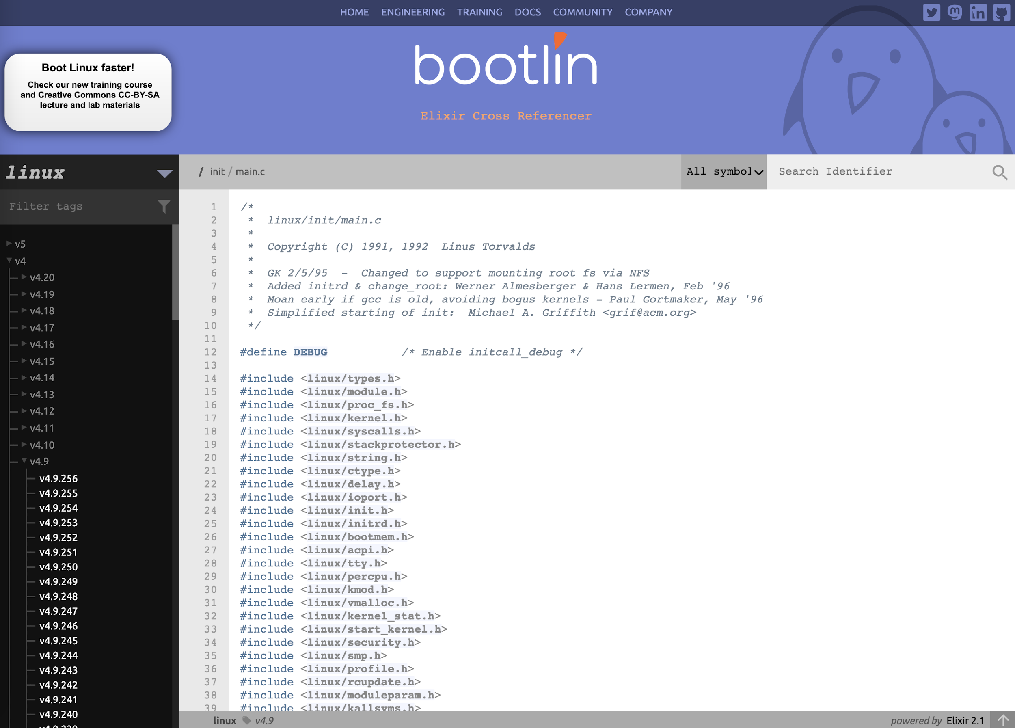
Linux Cross Reference (2)

Slide 25
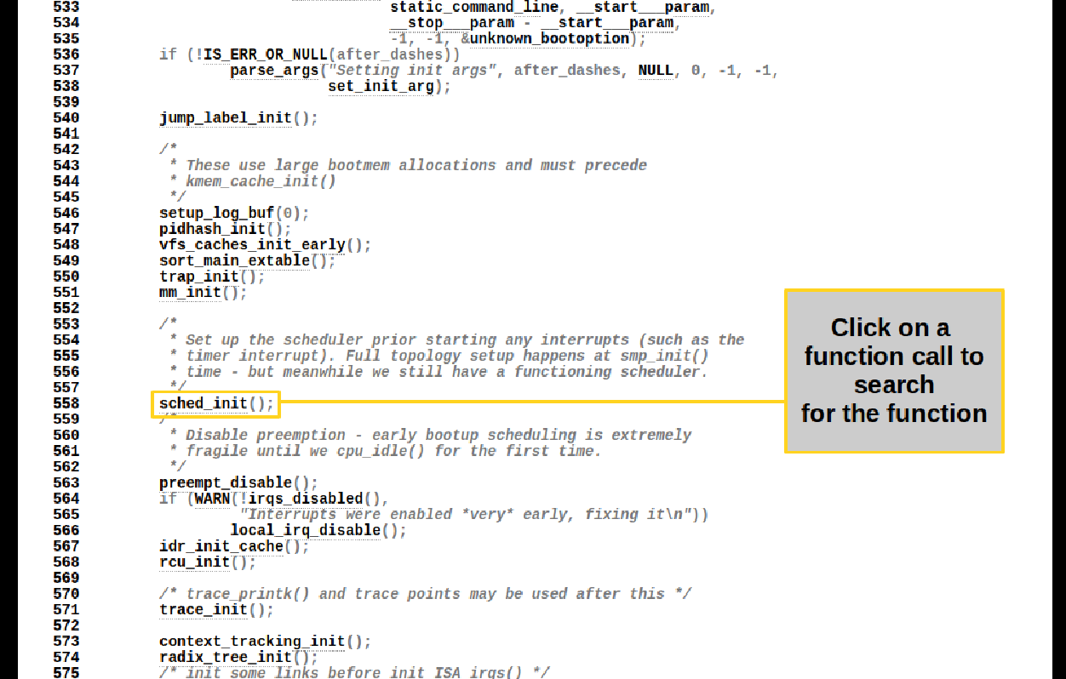
Linux Cross Reference (3)

Slide 26
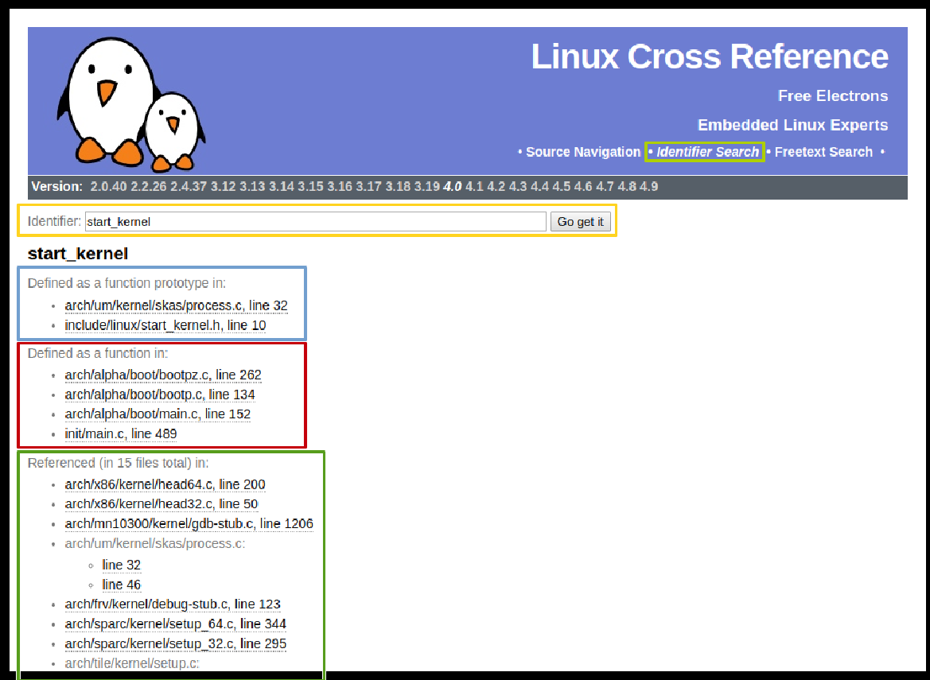
Linux Cross Reference (4)

Slide 27
Exploring the Source Code: Cscope
Command line tool to browse (potentially large) C codebases
Installation
$ sudo apt-get install cscope
Usage
$ cd linux_source_directory
$ make cscope
Build the database each time the code changes (just few seconds)
Search for
C identifier occurrences (variable name, function name, typedef/struct, label)
Functions/variables definitions
Functions called by/calling function f
Text string

Slide 28
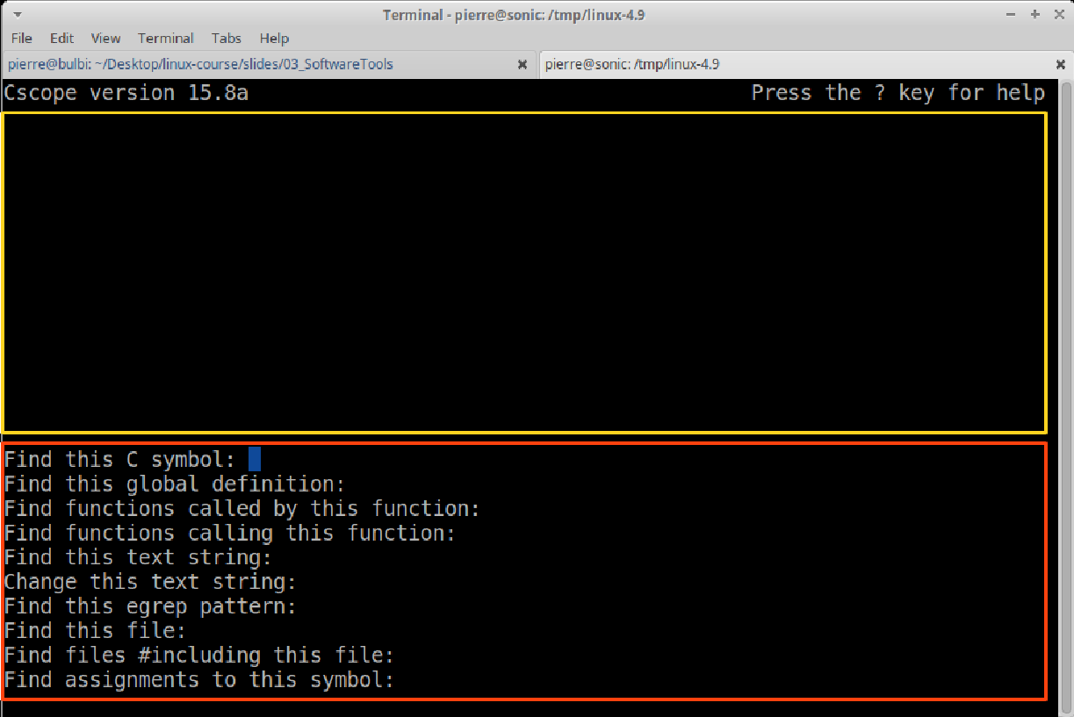
Cscope (1)

Slide 29
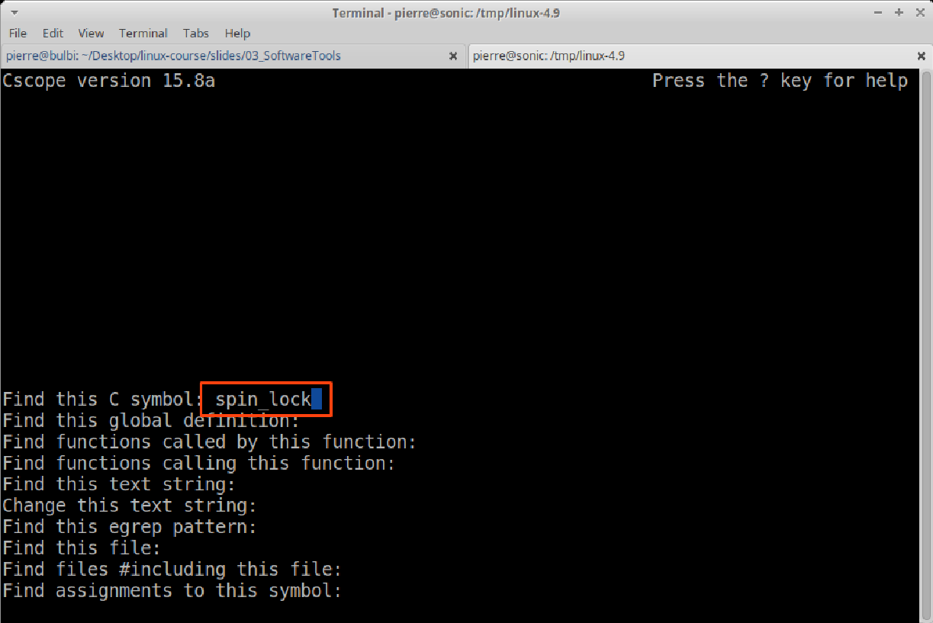
Cscope (2)

Slide 30
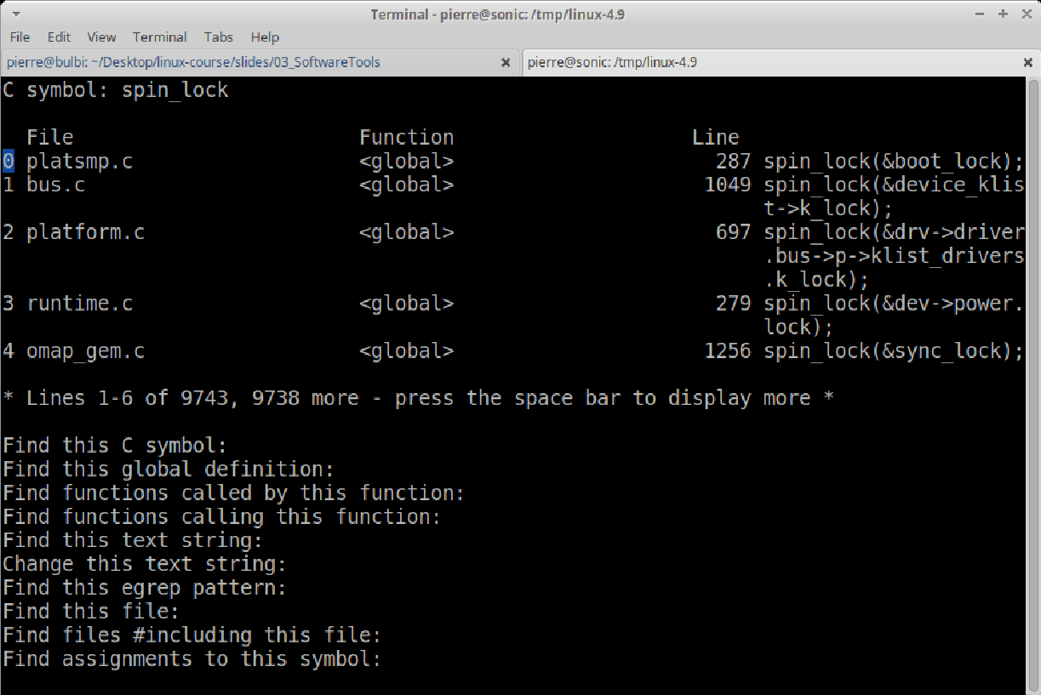
Cscope (3)

Slide 31
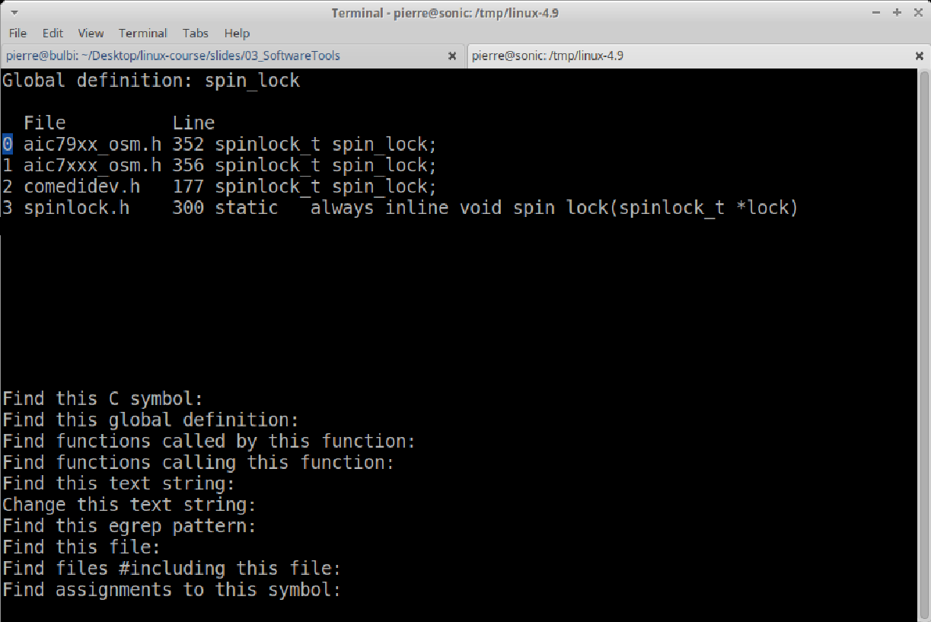
Cscope (4)

Slide 32
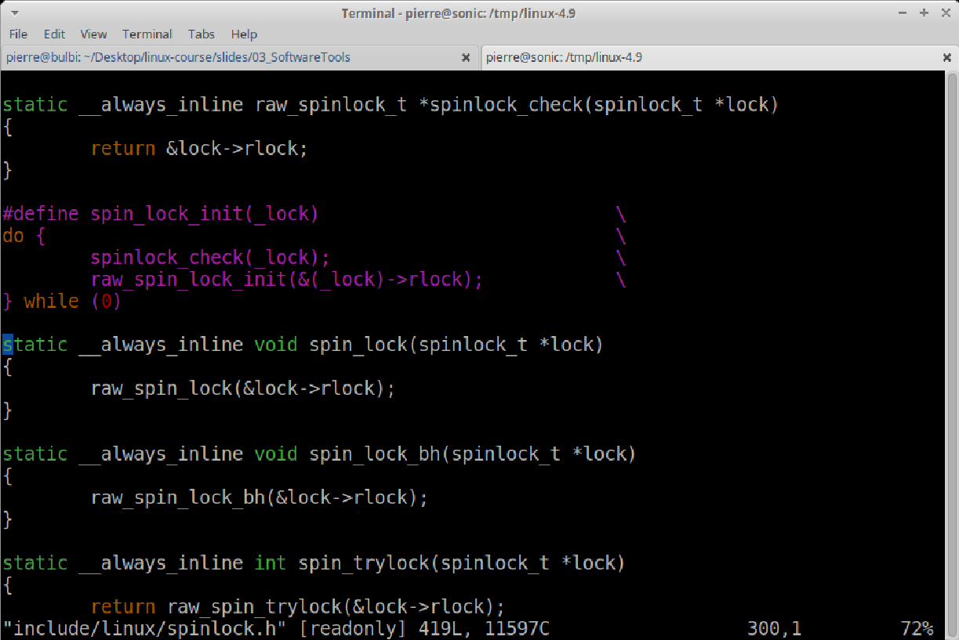
Cscope (5)

Slide 33
Other Options
OpenGrok: https://oracle.github.io/opengrok/
Plenty of IDEs have code browsing functionalities
Eclipse
…

Slide 34
Configuring, Compiling, and Installing the Linux Kernel (1)
Configure the kernel
$ make oldconfig
Compile the kernel
$ make –j 3 all
Install modules
# make modules_install
Install the kernel
# make install
For help
$ make help
I prefer to use
$ make menuconfig

Slide 35
Configuring, Compiling, and Installing the Linux Kernel (2)
Configuring the kernel
Linux’s default configurations
arch/x86/configs/
Distribution’s configurations
/boot/
Current running kernel’s configuration
/proc/config.gz
Which Linux kernel version are you currently running?
$ uname -a

Slide 36
Give it a try!
Copy the current configuration
$ cp /boot/config-`uname -r` .config
Configure the kernel
$ make menuconfig
Compile the kernel
$ make –j 3 all
Get a coffee (or tea)
Install modules
# make modules_install
Install the kernel
# make install
Update the bootloader (usually done by make install)
# update-grub2

Slide 37
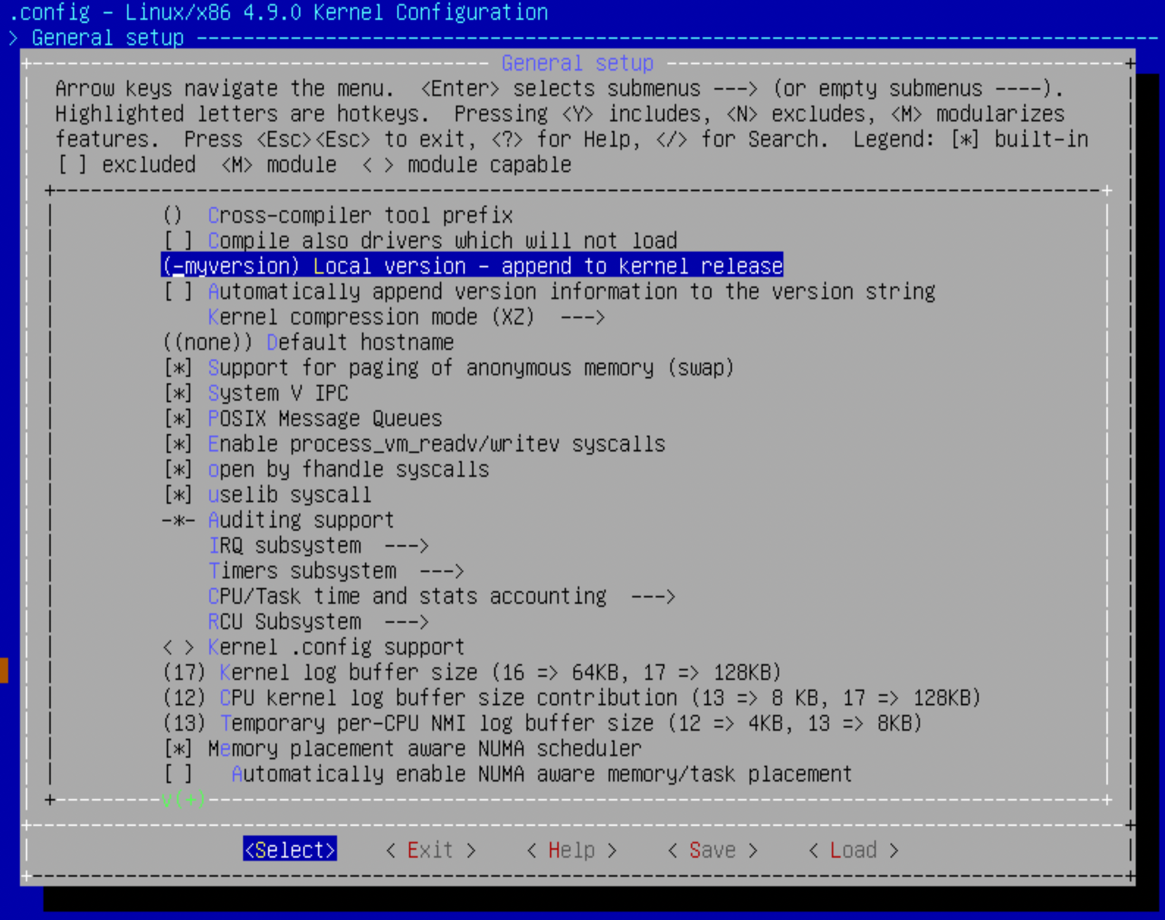
Set a Custom Kernel Version String
General Setup -> Local version
Save!

Slide 38
Linux Kernel Modules

Slide 39
Linux Kernel (Extensibility)
Linux supports dynamically loadable modules
In addition to the static in-kernel components
To add or replace
Device drivers
File system drivers
Networking protocols
Other kernel codes
Notes:
Modules are not shown in previous slides

Slide 40
Linux Kernel Module (1)
Piece of code that will run in the kernel (kernel-mode)
Super powers (privileged instructions, access all memory, etc.)
If it crash, it may crash the kernel
The code can be
part of the kernel source tree
outside the kernel source tree***

Slide 41
Linux Kernel Module (2)
How it works
Develop
Compile
Load the module in the kernel
Play with it
Unload the module from the kernel
requires the existence of a precompiled Linux kernel source tree
Or at least kernel headers
Shortens the development cycle
Can be loaded and unloaded (no reboot)
Doesn’t compile the entire kernel

Slide 42
The Hello World Module (Source)
#include <linux/module.h>
#include <linux/init.h>
static int hello_init(void)
{
printk(KERN_ALERT "Hello, world\n");
return 0;
}
static void hello_exit(void)
{
printk(KERN_ALERT "Goodbye, cruel world\n");
}
module_init(hello_init);
module_exit(hello_exit);
MODULE_LICENSE("Dual BSD/GPL");

Slide 43
The Hello World Module (Makefile)
# If KERNELRELEASE is defined, we've been invoked from the
# kernel build system and can use its language.
ifneq ($(KERNELRELEASE),)
obj-m := hello.o
# Otherwise we were called directly from the command
# line; invoke the kernel build system.
else
KERNELDIR ?= /lib/modules/$(shell uname -r)/build
PWD := $(shell pwd)
default:
$(MAKE) -C $(KERNELDIR) M=$(PWD) modules
endif

Slide 44
The Hello World Module (in action)
% make
make[1]: Entering directory `/usr/src/linux-2.6.10'
CC [M] /home/ldd3/src/misc-modules/hello.o
Building modules, stage 2.
MODPOST
CC /home/ldd3/src/misc-modules/hello.mod.o
LD [M] /home/ldd3/src/misc-modules/hello.ko
make[1]: Leaving directory `/usr/src/linux-2.6.10'
% su
root# insmod ./hello.ko
Hello, world
root# rmmod hello
Goodbye cruel world
root#
Compile
Load the
module
Unload the
module
Notes:
This is from the book but I should show them the same on the virtual machine

Slide 45
Module Commands
lsmod
List currently running modules
Looks at /proc/modules
modinfo module_path
Infos about a kernel module
Description, kernel version, parameter(s), author(s), etc.
rmmod module_name
Removes a loaded kernel module
insmod module_path
Insert a kernel module based on the module’s path
modprobe
modules from the kernel sources are in a standard location on the filesystem
/lib/modules/<kernel version>/
These can be inserted through modprobe
modprobe module_name
Contrary to insmod, modprobe handles modules dependencies
Dependency list generated in
/lib/modules/<kernel version/modules.dep
Remove using modprobe
modprobe -r module_name

Slide 46
What Functions Can I call?
Module is linked against the entire kernel
Module has visibility of all kernel
Global variables
Exported functions
Kernel symbols table at
/proc/kallsyms
/boot/System.map*
Is there a libc? No!
But most of the same functions are available

Slide 47
How to Make a Function Callable?
EXPORT_SYMBOL(name);
EXPORT_SYMBOL_GPL(name);
Notes:
Either of the above macros makes the given symbol available outside the module.
The _GPL version makes the symbol available to GPL-licensed modules only. Symbols
must be exported in the global part of the module’s file, outside of any function,
because the macros expand to the declaration of a special-purpose variable that
is expected to be accessible globally. This variable is stored in a special part of the
module executible (an “ELF section”)that is used by the kernel at load time to find
the variables exported by the module. (Interested readers can look at <linux/module.h>
for the details, even though the details are not needed to make things work.)

Slide 48
printk(): Linux Kernel’s printf()
Same function arguments as printf()
int printk(const char * fmt, ...);
But the first argument is prefixed by the print’s priority (loglevel)
KERN_EMERG, KERN_ALERT, KERN_CIRT, KERN_ERR, KERN_WARNING, KERN_NOTICE, KERN_INFO, KERN_DEBUG
printf() output is a console/shell
printk() output is the kernel log
Based on the print’s priority the message may or may not appear on your console
Live stream of the log
/dev/kmsg
Klogd and syslogd write the log to
/var/log/messages
/var/log/kern.log
Additionally
$ dmesg
Notes:
The kernel needs its own
printing function because it runs by itself, without the help of the C library. The
module can call printk because, after insmod has loaded it, the module is linked to
the kernel and can access the kernel’s public symbols (functions and variables, as
detailed in the next section)

